Slide 1
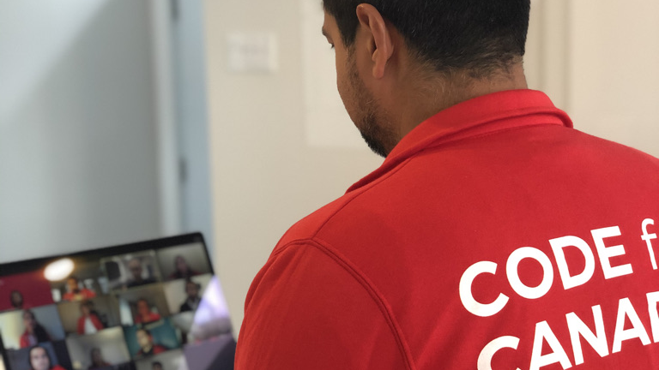
Notes:
And there was a couple of things that helped me:
One. Building the smallest possible thing, and celebrating every win, no matter how small.
I would literally build the tiniest code update, and then share it with the team and celebrate the thing.
And that helped build momentum, and push back against some of the doubt.

Slide 2
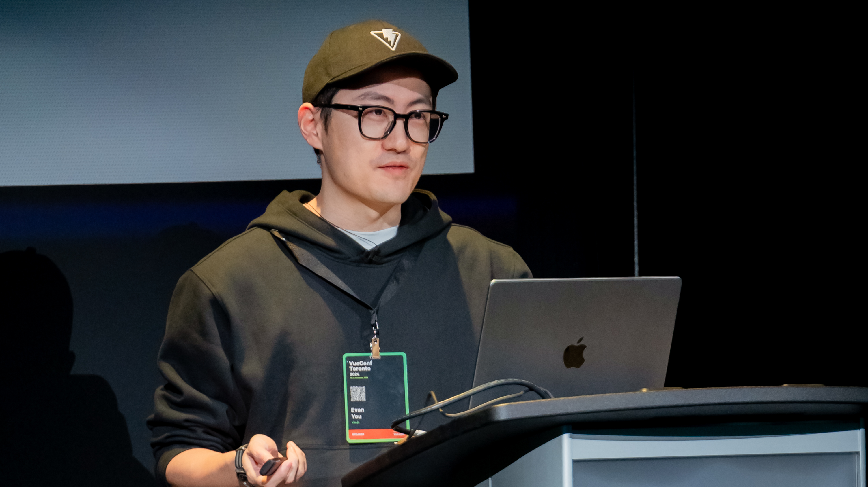
Notes:
The other thing that really helped me, was the developer community.
This is Evan You, he is absolutely brilliant, and he created a tool that I absolutely love using - it’s called Vue.js.
Vue.js is the first tool that I reach for when I’m building software, and I recommend you reach for it as well for modern apps.
I remember reaching out to the Vue.js community to ask for help on our project, and he actually replied.

Slide 3
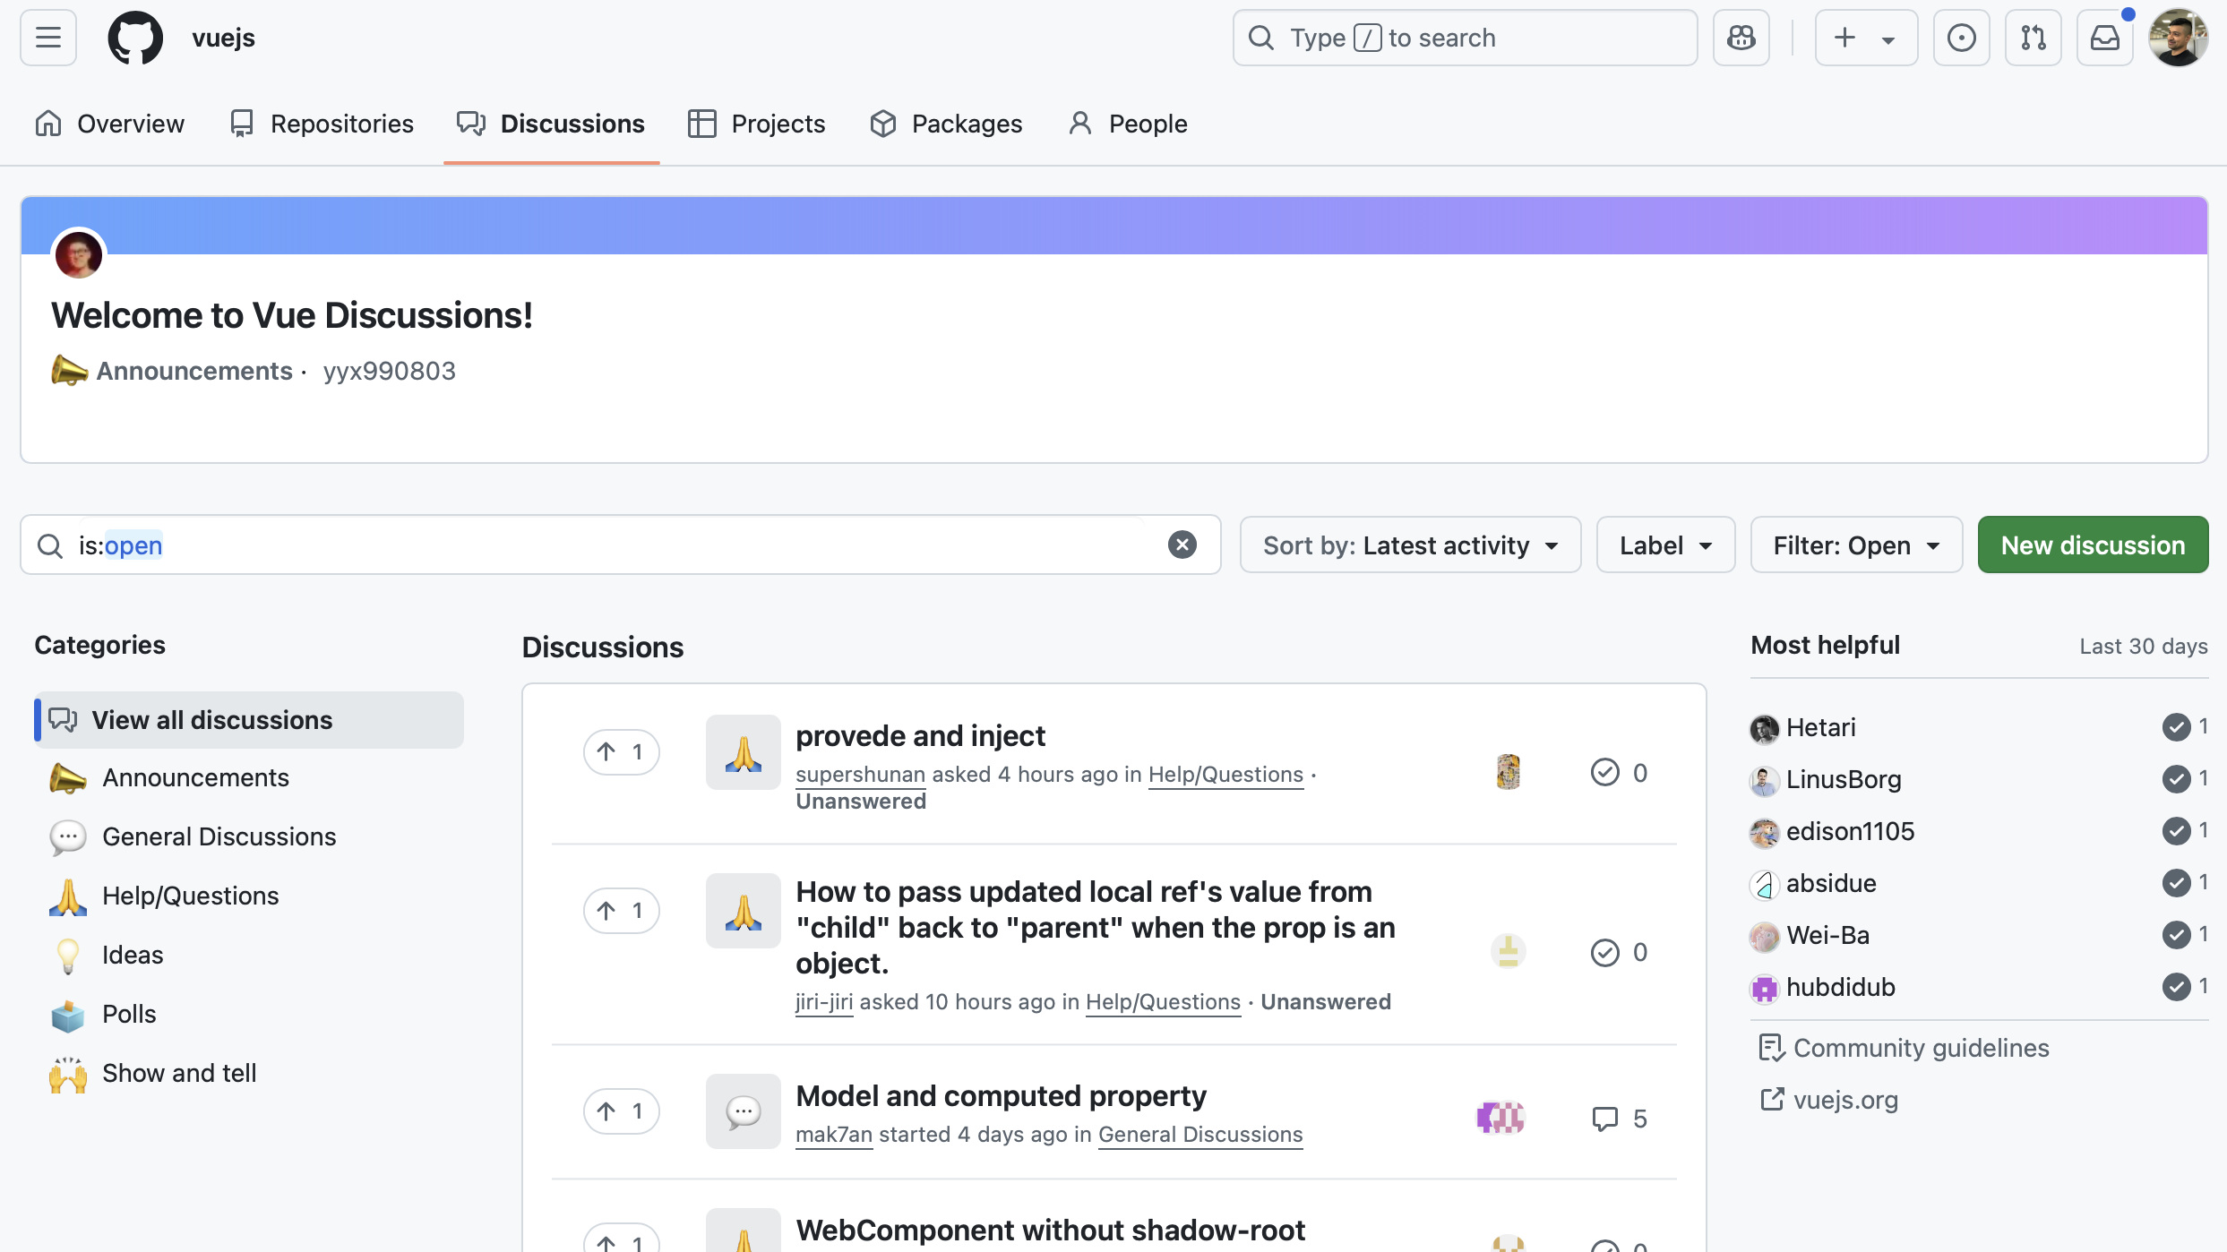
Notes:
And it wasn’t just Even.
It blew my mind that so many developers the world over would take time out of their day to help me solve a problem.
They helped me unblock issues, which in turn then gave me the confidence to take on the next small problem and the next small problem.

Slide 4
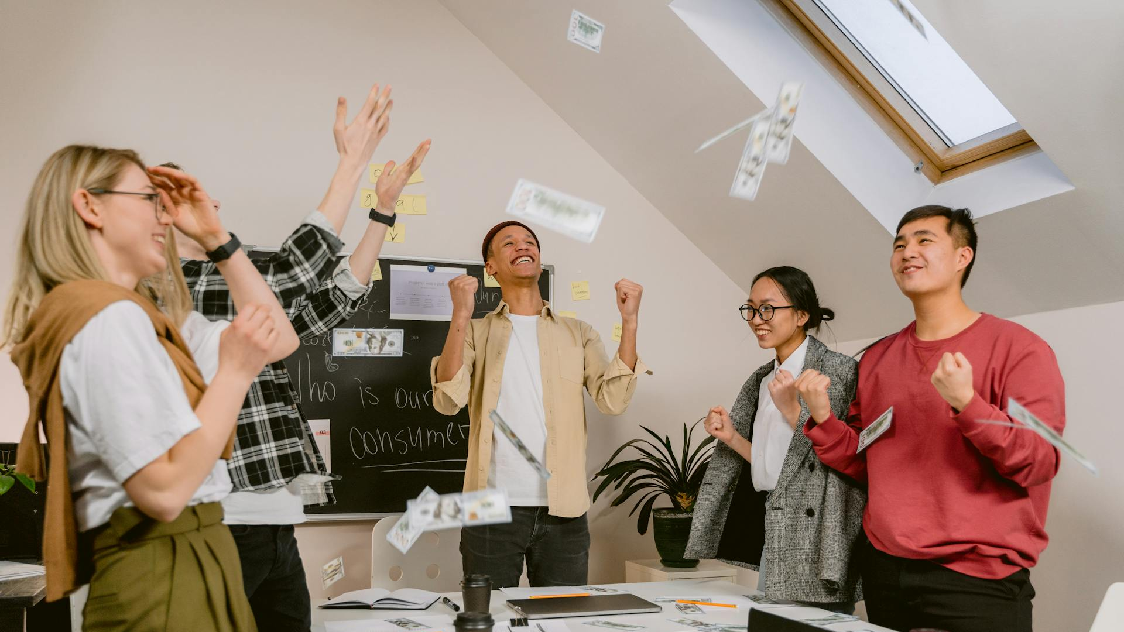
Notes:
And so, little tiny tasks turn into bigger and bigger wins.
Procrastination, which had been manifesting at the start of the project, now seemed a distant memory.
Momentum really started to take shape. And those feelings of doubt started to subside.

Slide 5
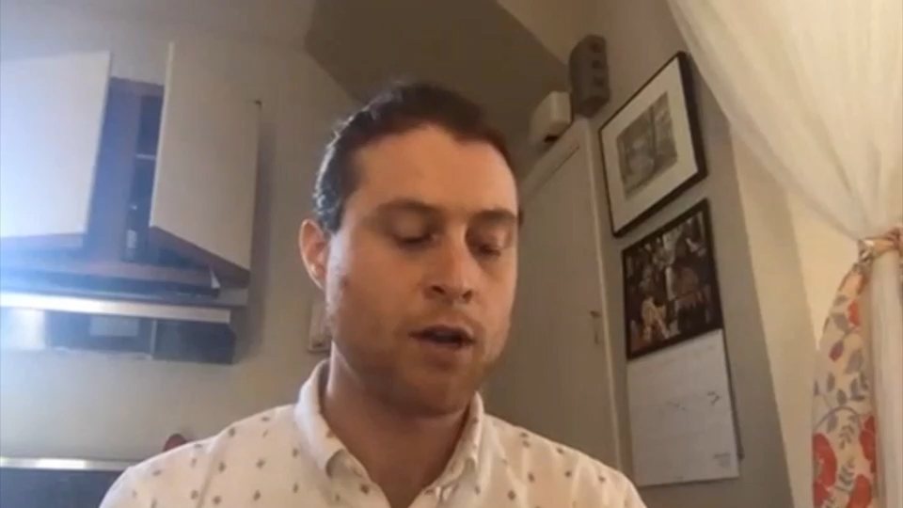
Notes:
And, you just keep going until you have something big enough to show to your stakeholders.
This is a picture of a prototype that we built of a holographic assistant to help users navigate and better understand why their Employment Insurance was being paid out.
It allowed us to do some user testing and really learn how people might interact with an assistant.

Slide 6
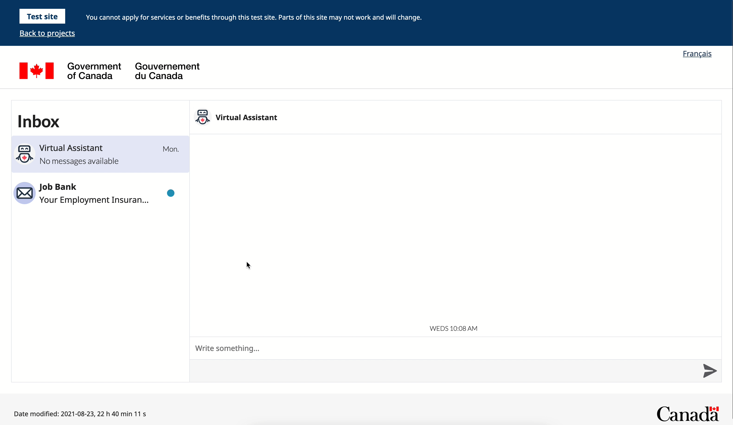
Notes:
And then a funny thing happens when you stack up enough little wins. Day by day, meeting by meeting, decision by decision.
You look up one day and realize - wow, we actually built this thing.
A thing that exists now, that we can test with users, and show our stakeholders.
And somehow, while I was busy doubting yourself, I was actually just... doing the job.

